Slide 1
ADC, Coil temperature
ADC
Sense resistor’s
Temperature dependence
Cap probe, clock
OR
Cal V Measured V Velocity

Slide 2
If we follow the experimental method described in Aliter, the uncertainty in unknown mass measurement is only a function of m_{ref}, Vref, V_{m} . Assuming the resistance, R of the sense resistor is the “same” in between the two experiments involving reference mass and unknown mass, and are performed in quick intervals, say within a minute. However, data of resistance variation with respect to temperature could be useful to assess the influence. This data is not available currently. Obtaining the data is a future work.

Slide 3
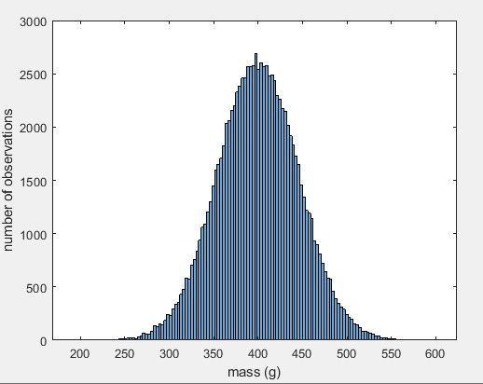
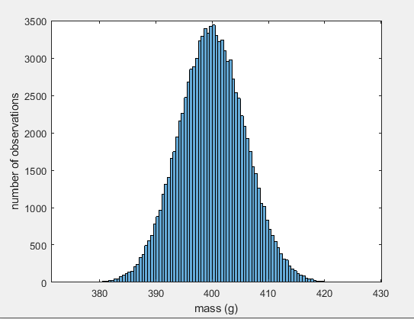
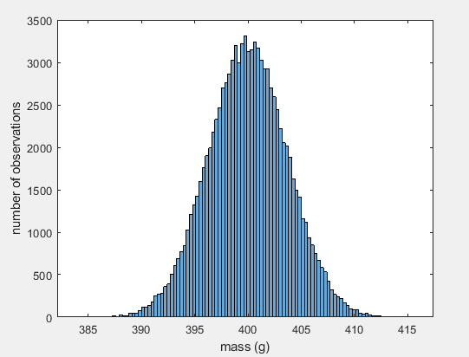

Slide 4
Resolution of ADC measuring
capacitance probe,
Humidity settles water vapor on
capacitance probe’s electrode
Resolution of MyRIO’s clock
Resolution of ADC
Measurand,
Geographical location
Temperature affects
length of coil,
and remanence
Temperature

